Slide 1
INTRUDER DETECTION SYSTEM
An Internet Of Things Project
Course Code ECE (363)
Guided By Ms. Aarti

Slide 2
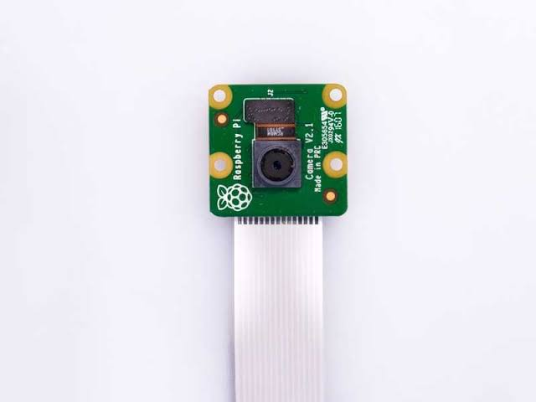
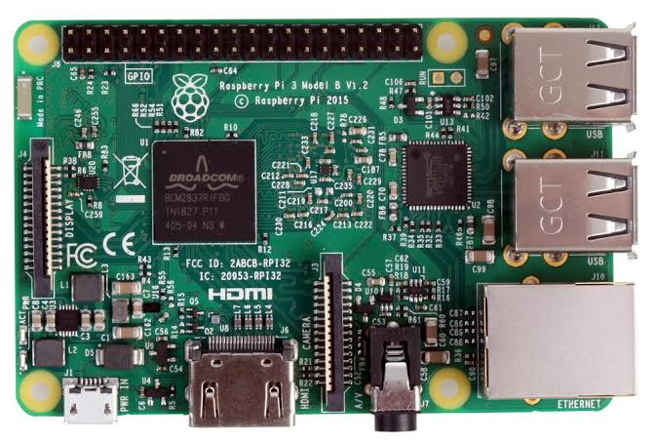
COMPONENTS REQUIRED
RASPBERRY PI
PI CAMERA

Slide 3
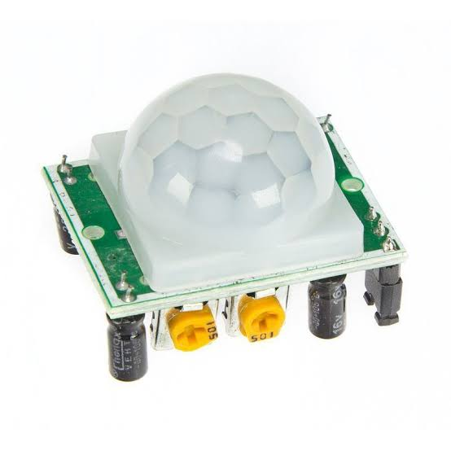
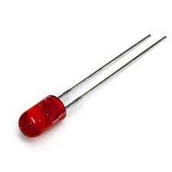
COMPONENTS REQUIRED
PIR SENSOR
LED

Slide 4
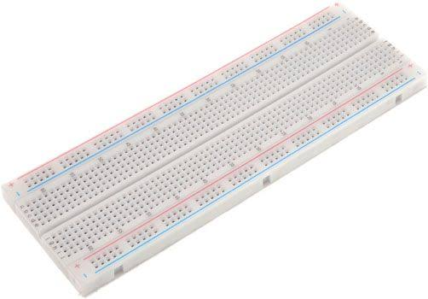
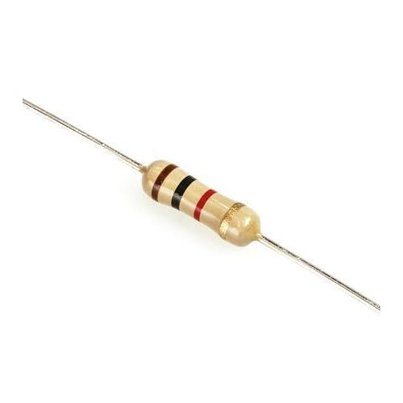
COMPONENTS REQUIRED
BREAD BOARD
RESISTOR

Slide 5
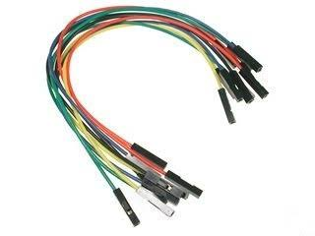
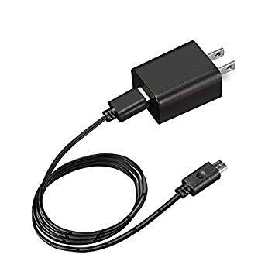
COMPONENTS REQUIRED
CONNECTING WIRES
POWER SUPPLY

Slide 6
APPLICATIONS
The most important application of Intruder Detection System is to detect the unauthorized trespasser getting into a particular place without authorization for some unfair means.
Used for military applications as well especially in borders for ensuring safety around the LOC.

Slide 7
LIBRARY FILES USED FOR CONFIGURATION
Installing pi camera library:
Commands used
Sudo apt-get install python-picamera
Sudo apt-get installpython3-picamera
Sudo raspi-config
Setting up ssmtp libraries:
Sudo apt-get install ssmtp
Sudo apt-get install mailutils
Sudo nano /etc/ssmtp/ssmtp.config
Installing MIME library:
Import RPi.GPIO as gpio Import picamera import time import smtplib from email.mime.multipart import MIMEMultipart
from email.mime.text import MIMEText from email.mime.base import MIMEBase

Slide 8
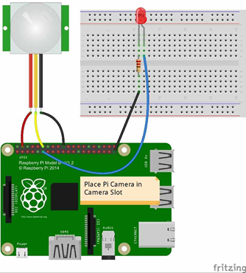
CIRCUIT DIAGRAM

Slide 9

THANK
YOU

